Slide 1
30,000 Spotify songs analysis
Model for predicting music genres

Slide 2
Introduction: -
In the contemporary era of digitized music consumption, vast repositories of song data provide an unprecedented opportunity for exploration and analysis. The dataset encapsulates a trove of information pertaining to 30,000 Spotify songs, offering a comprehensive view into the intricate world of music. This dataset not only serves as a testament to the diversity of musical expressions but also acts as a fertile ground for the application of machine learning techniques, with the goal of predicting song genres.
The preprocessing of the dataset is a pivotal initial step, ensuring the data's cleanliness, consistency, and suitability for advanced analyses. Steps such as handling missing values, normalizing numerical features, and encoding categorical variables form an integral part of this process, laying the foundation for robust model development. Once the data is refined, a journey of exploration begins through insightful visualizations that unravel hidden patterns and relationships within the music data. This phase provides a contextual understanding of the dataset, setting the stage for the subsequent predictive modeling.
At the core of this study lies the ambitious endeavor to predict the genre of each song. Adopting a diverse set of Machine Learning models, including Naive Bayesian, Bayesian Belief Network, Decision Tree (Entropy, and error estimation), LDA, Neural Network, and K-NN with different distance metrics, this study aims to explore the efficacy of these models in discerning the intricate nuances of musical genres. Each model brings its unique strengths and characteristics, offering a diverse landscape for evaluation.
The evaluations are not merely limited to accuracy metrics but delve deeper into the nuances of model performance. K-fold cross-validation with average accuracy ensures robustness, providing a comprehensive assessment of each model's generalizability. Metrics such as Confusion Matrix, Accuracy, Error rate, Precision, Recall, F-measure, and ROC analysis offer a nuanced understanding of the models' classification abilities, shedding light on their strengths and potential areas for improvement.
This research, situated at the intersection of data science and music analytics, aspires to contribute valuable insights to both fields. Beyond the technicalities of predictive modeling, the study aims to uncover broader trends within the dataset, fostering a deeper appreciation for the intricate interplay between musical attributes and genres. Ultimately, this exploration stands as a testament to the boundless possibilities that emerge when the world of music converges with the power of data-driven insights.

Slide 3
Dataset description
The dataset consists of columns describing songs by its danceability, energy etc.
Categorical columns include track_name, track_artist etc.
Numerical columns (used as features) include danceability, key, loudness etc.
The features would be selected to help the model predict the song genre includes the danceability, energy, key, loudness etc.
Comaring all these columns to the target which would be the play_list genre to help us determine the song genre.`

Slide 4
Methodology: -
Data Collection:
Collect the dataset containing Spotify songs information, including audio features and genre labels.
Data Preprocessing:
Handle missing values by either dropping or imputing them.
Visualize data through histograms, boxplots, and pair plots to understand feature distributions and relationships.
Trim outliers in key features to improve model robustness.
Discretize numeric features like danceability, energy, and tempo.
Encode categorical variables and label-encode the target variable, 'playlist_genre'.
Exploratory Data Analysis (EDA):
Compute basic statistics (Min, Max, Mean, Variance, Standard Deviation, Skewness, Kurtosis) for numeric features.
Visualize genre distribution using bar charts and pie charts.
Analyze the correlation and covariance between audio features.
Conduct a chi-square test to assess independence between categorical variables.
Feature Reduction:
Implement Linear Discriminant Analysis (LDA), Principal Component Analysis (PCA), and Singular Value Decomposition (SVD) to reduce feature dimensions.

Slide 5
Model Building:
Train various models, including Decision Tree, Naive Bayes, LDA, K-NN, Neural Network, and Random Forest, to predict playlist genres.
Model Evaluation:
Split the dataset into 80% training and 20% testing sets.
Apply K-fold cross-validation and calculate average accuracy for each fold.
Generate confusion matrices for each classifier, evaluating accuracy, error rate, precision, recall, F-measure, and ROC-AUC.
Check for potential overfitting or underfitting by comparing training and testing set accuracies.

Slide 6
Results
The dataset consists of columns describing songs by its danceability, energy etc.
The goal here is to focus on our target column the ‘playlist_genre’ and predict all the songs proper genres.
Data pre-processing and visualization:
Now the results of the preprocessing, the dataset contained MASSIVE amounts of outliers, we had to properly manage them for example the danceability column

Slide 7
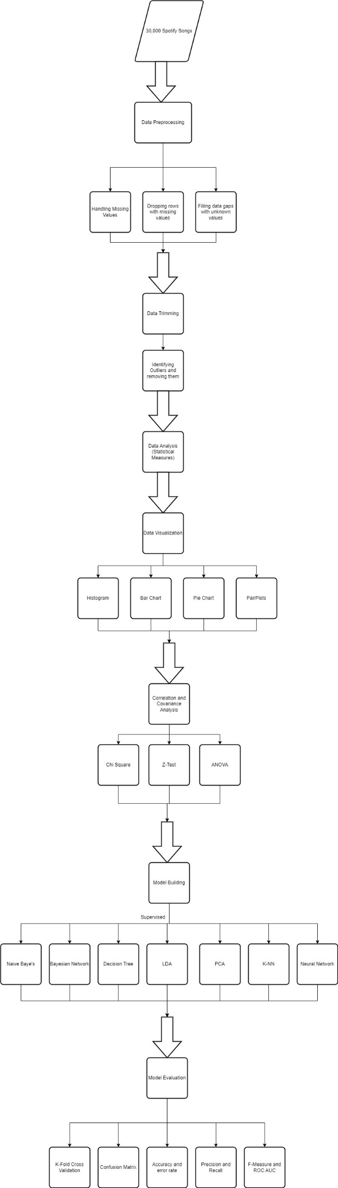
Concept flow

Slide 8
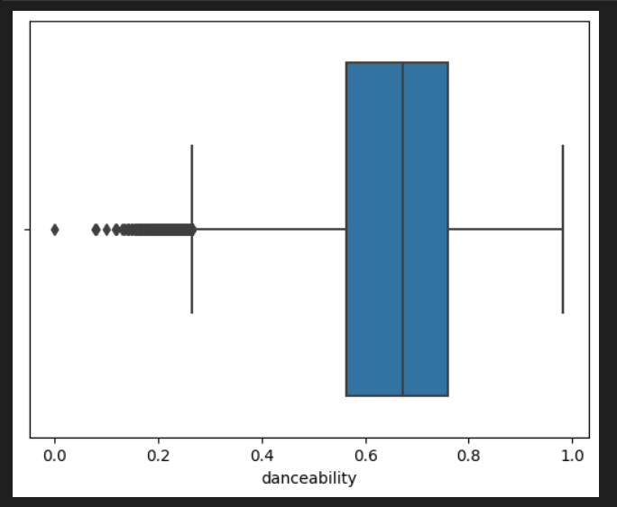
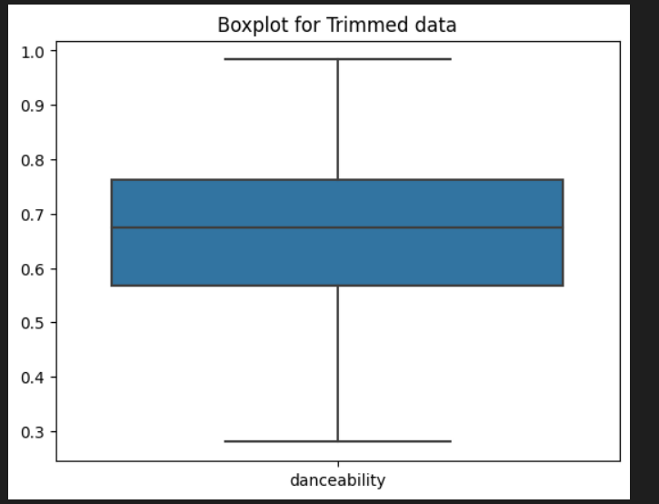
Data Showcase
The dataset consists of columns describing songs by its danceability, energy etc.
The goal here is to focus on our target column the ‘playlist_genre’ and predict all the songs proper genres.
Data pre-processing and visualization:
Now the results of the preprocessing, the dataset contained MASSIVE amounts of outliers, we had to properly manage them for example the danceability column.

Slide 9
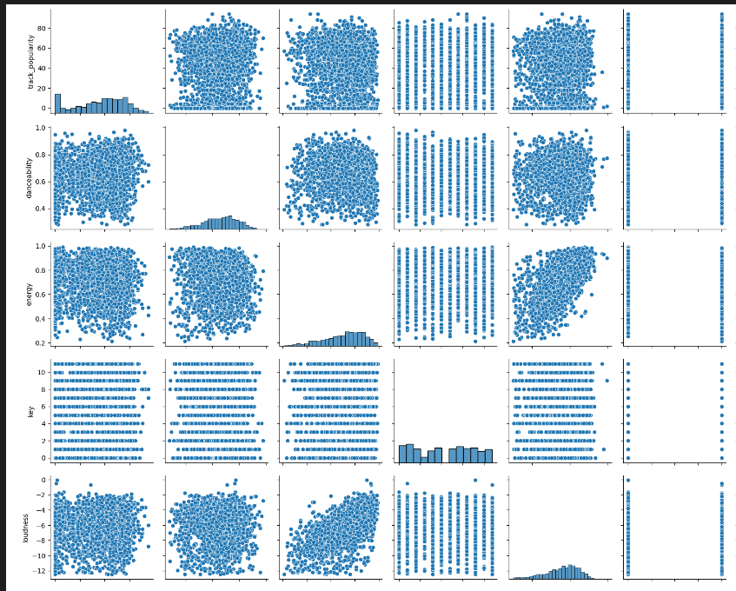
Visualizing the data

Slide 10
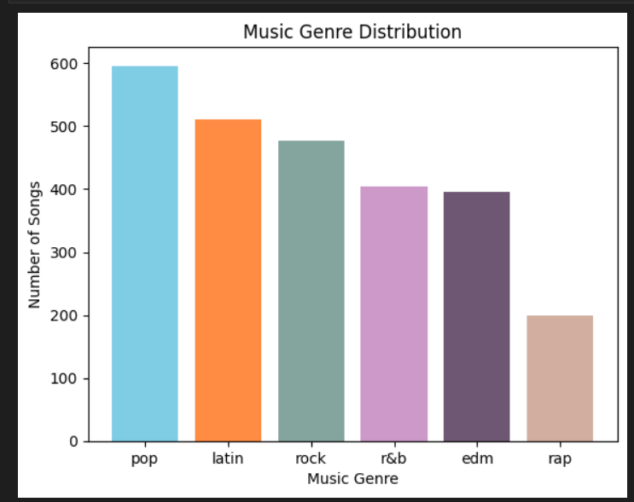
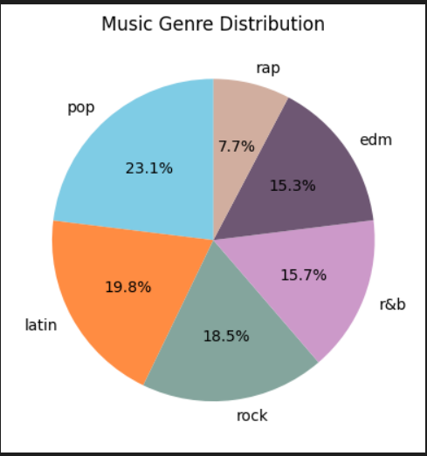
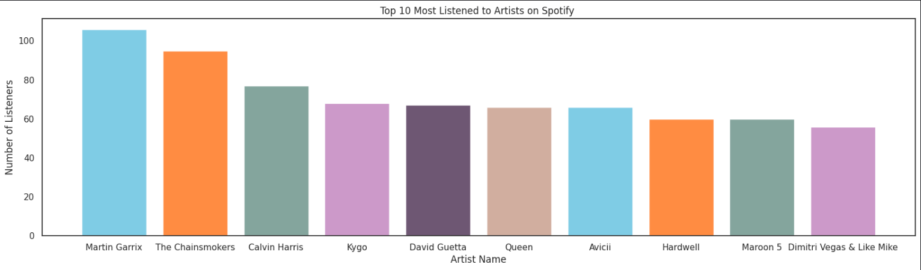

Slide 11
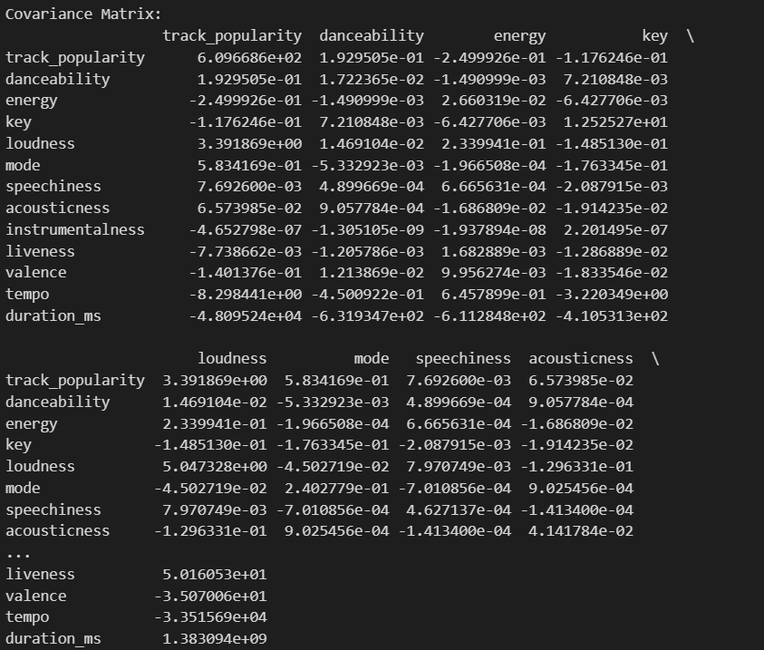
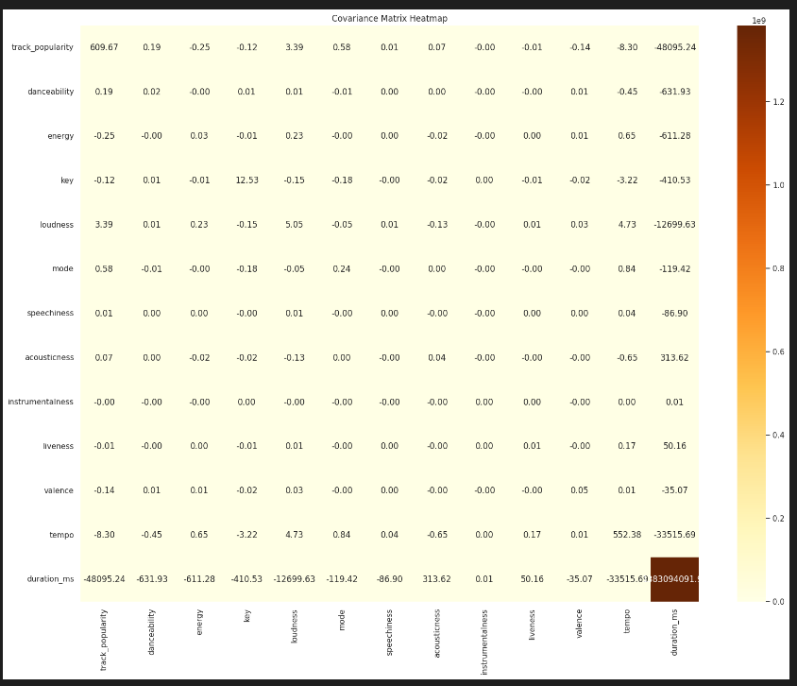
Results

Slide 12
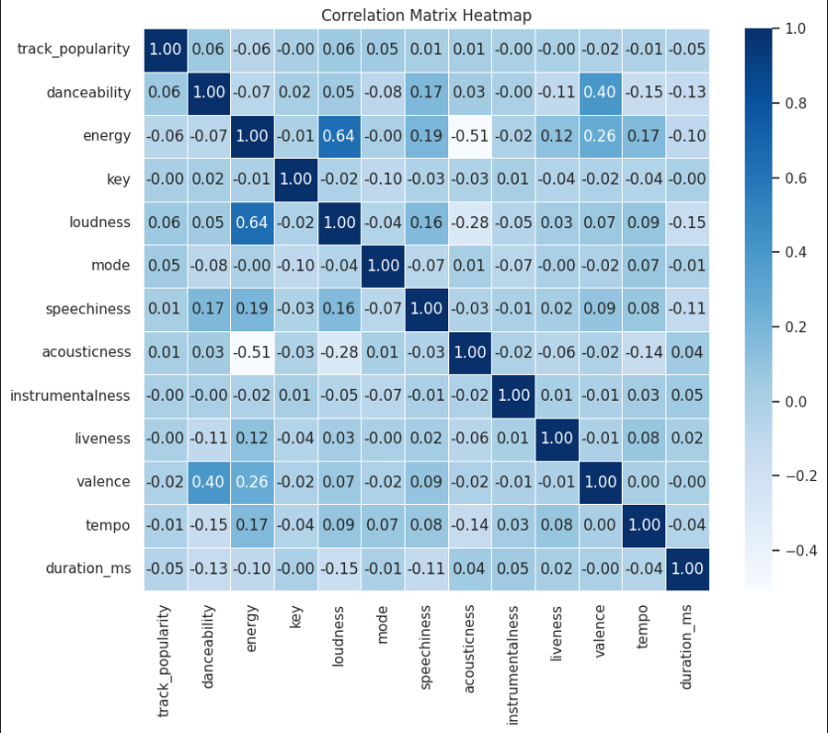
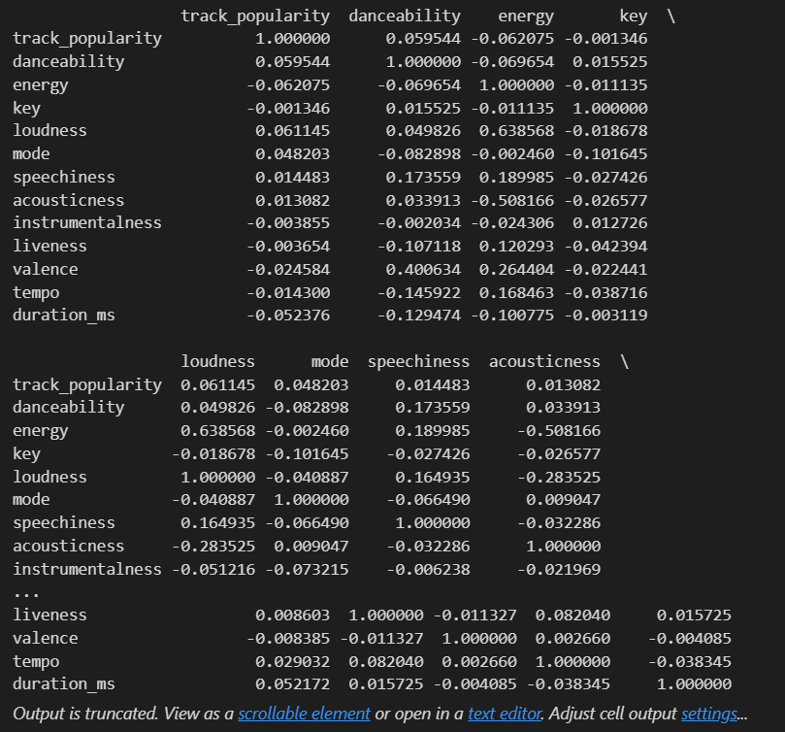
Correlation Matrix

Slide 13
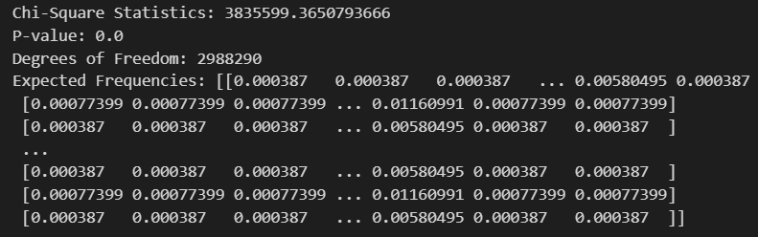
Chi Square test

Slide 14

Z-Test

Slide 15

ANOVA

Slide 16
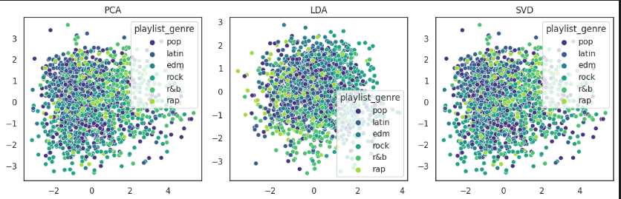
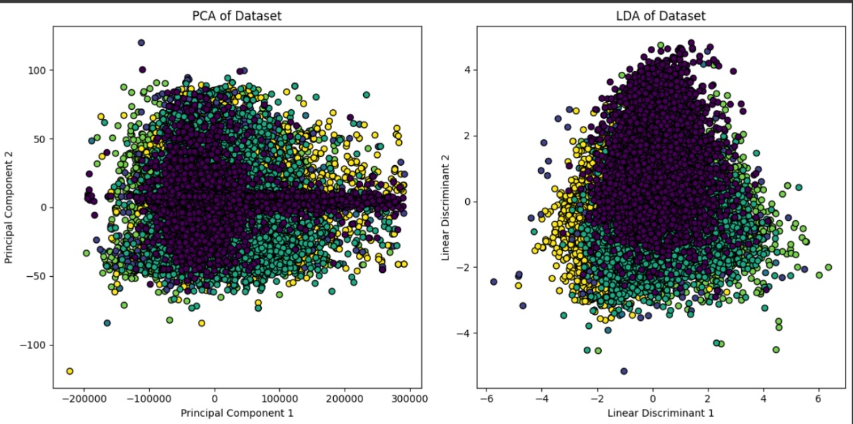
PCA LDA SVD

Slide 17
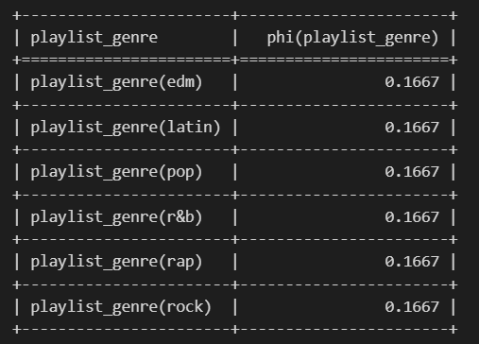
Basyesian Belief Network

Slide 18
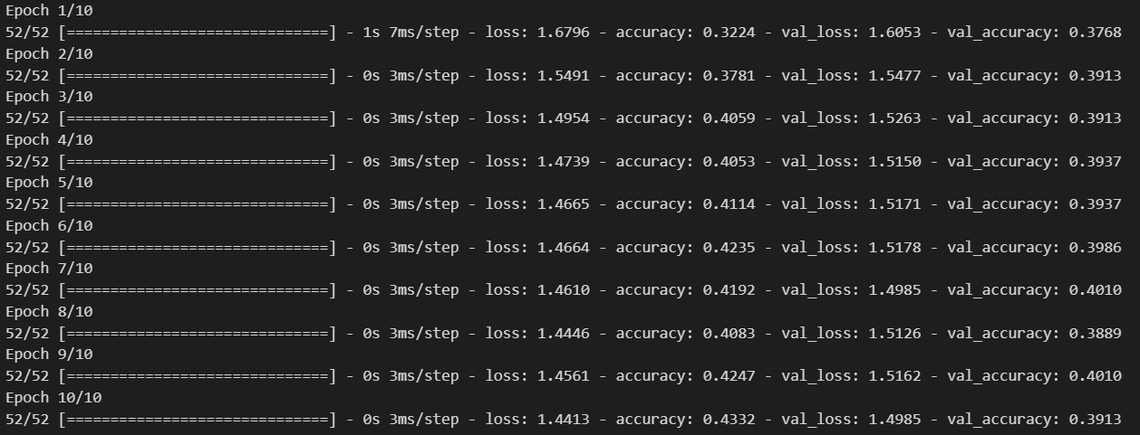
Neural Network

Slide 19
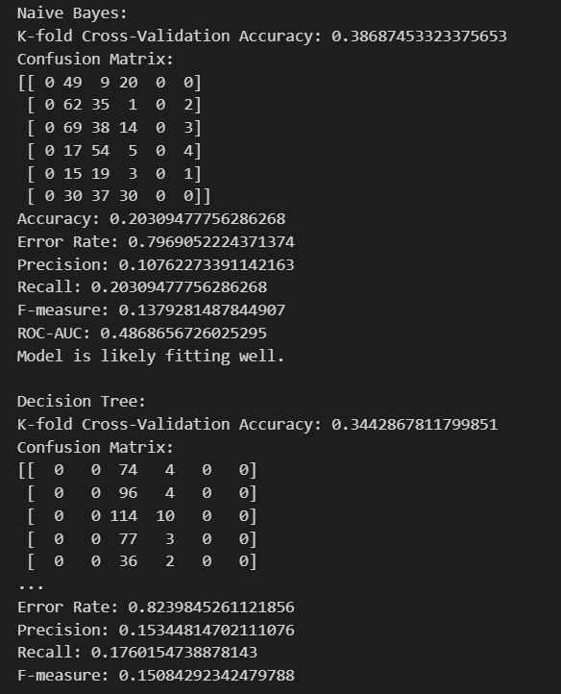
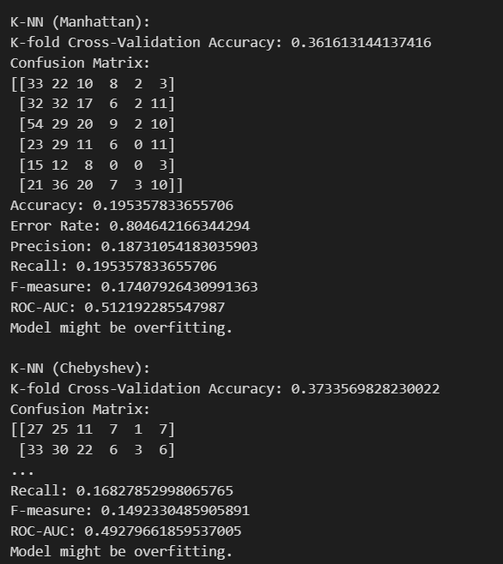

Model results

Slide 20
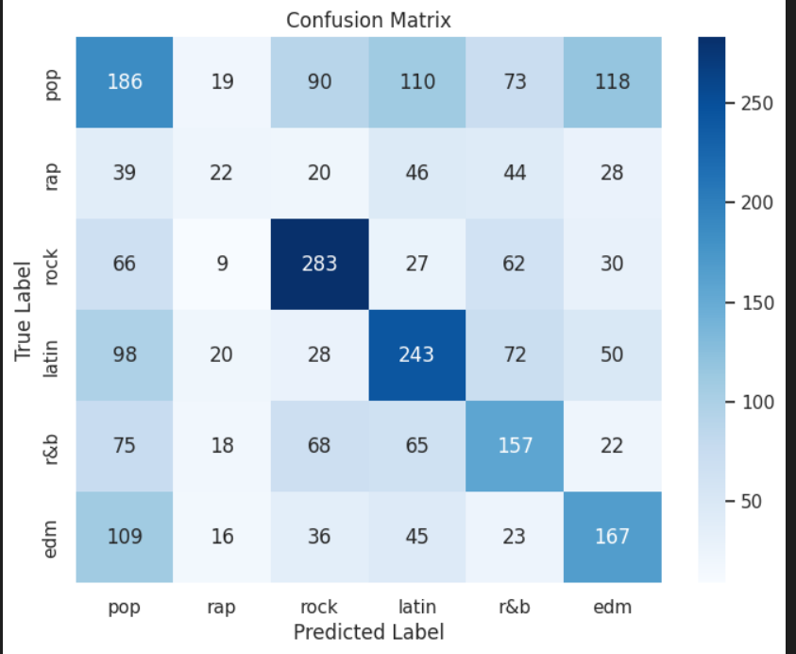
Predicted Confusion Matrix

Slide 21
Conclusion
In conclusion, the proposed methodology aimed to leverage audio features of Spotify songs to predict playlist genres. Overall, the accuracy is very low. However, compared to the reference model’s accuracy it’s a significant increase of around 7% higher. Which concludes the study of our project.

Slide 22
References
Van den Oord, A., Dieleman, S., & Schrauwen, B. (2013). Deep Content-Based Music Recommendation. [arXiv:1303.1788]
Tzanetakis, G., & Cook, P. (2002). Automatic Musical Genre Classification of Audio Signals. IEEE Transactions on Speech and Audio Processing.
Yang, Y.-H., & Chen, H. H. (2013). Music Emotion Recognition: A State of the Art Review. IEEE Transactions on Audio, Speech, and Language Processing.
Won, M., & Park, J. (2018). Content-Based Music Genre Classification Using Deep Learning. International Society for Music Information Retrieval Conference.

Slide 23
Chen, Y.-H., Yu, L.-C., & Yang, Y.-H. (2017). A Survey on Music Emotion Recognition: From Signals to Lyrics. Journal of King Saud University - Computer and Information Sciences.
Pal, A. R., Kumar, S. K., & Saha, S. K. (2018). Music Genre Classification: A Class in Review, Techniques and Challenges. Expert Systems with Applications.
Müller, M. (2007). A Survey of Audio-Based Music Classification and Annotation. IEEE Transactions on Multimedia.
Choi, K., Fazekas, G., & Sandler, M. (2016). Learning Hierarchical Representations for Music Genre Classification Using Convolutional Neural Networks. [arXiv:1603.00930]
Lee, J., Park, J., & Nam, J. (2016). Convolutional Recurrent Neural Networks for Music Classification. [arXiv:1609.04243]
Seneviratne, S. D. S., Fernando, T. N. G. I., & Kodagoda, S. (2014). A Comprehensive Review on Audio-based Music Classification and Annotation. Journal of Computer Science and Technology.

